Slide 1
Hard Disk Drive Reliability Statistics and Analysis
Saurabh Bhagwat(17211349)
Lavleen Bhat (17210637)

Slide 2
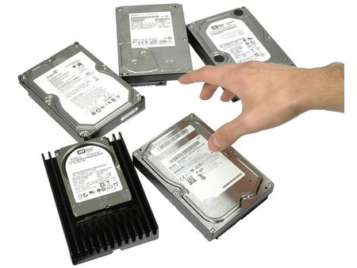
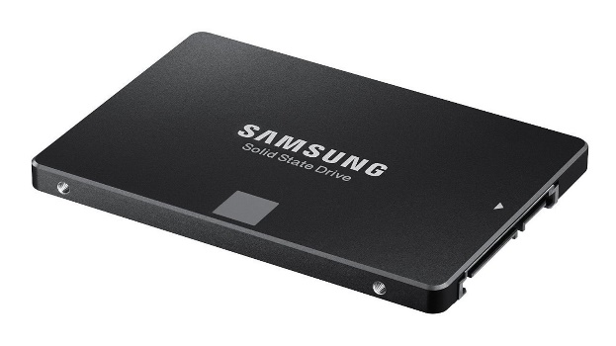




Which Hard Drive should I buy ?

Slide 3
Questions
Which hard drive to purchase?
Life expectancy? (Reliability)
Which brand to buy?
Which model to buy?
Does temperature affect the failure rate?
What about other SMART stats attributes?
Enterprise drives vs Consumer drives
Using Machine Learning Techniques :
Prediction of hard drive failures in Future
Prediction and recommendation of brands in future

Slide 4
Shortlisted SMART stats
194 - Temperature_Celsius
SMART 5 - Reallocated_Sector_Count.
SMART 187 - Reported_Uncorrectable_Errors.
SMART 188 - Command_Timeout.
SMART 197 - Current_Pending_Sector_Count.
SMART 198 - Offline_Uncorrectable
2 (optional)
9 - Power_On_Hours
192 - Power-Off_Retract_Count

Slide 5
Progress so far:
Data transformation
Data merging
Next action plan:
Data processing – Handling missing values
Visualization

Slide 6
Dataset
Source : https://www.backblaze.com/b2/hard-drive-test-data.html
Data from 2013-2017 (Quarter-wise)
Fields :
Date
Model
Capacity
Serial Number
Failure (0 &1)
Smart Stats (Temp, Performance, Throughput, Power-cycle, etc.)

Slide 7
How messy the data is?
Blank fields - done
Inconsistent fields - done
Variation in number of entries in each file
Out-of-bound values - Next
Missing data - Next

Slide 8
Any Questions?

